Slide 1

Speaker Identification
7th Semester
MINOR PROJECT
Deepanshi Bansal Shivangi Singla

Slide 2
Overview
Multiple Speaker identification can be used in conversations, where multiple speakers are talking simultaneously over a single recording channel, identifying which is a challenging problem right now.
Speaker clustering describes the task of telling who spoke when for a sequence of utterances, without prior knowledge of neither the number nor identities of speakers
Segments of the same set of selected phonemes by the object speaker and all suspect speakers are Fourier transformed. These phoneme spectra, and features derived therefrom, are utilized to make measures of voice similarity.

Slide 3
Project Objective
The human speech contains numerous discriminative features that can be used to identify speakers. Speech contains significant energy from zero frequency up to around 5 kHz. The objective of Automatic Multiple-Speaker Recognition is to extract, characterize and identify the speaker.
To study the properties of speech signal the concept of time varying Fourier representation and different models are used. However, the temporal properties of speech signal such, as energy, zero crossing, correlation etc are assumed constant over a short period. That is its characteristics are short-time stationary . Therefore, using hamming window, Speech signal is divided into a number of blocks of short duration so that normal Fourier transform can be used.

Slide 4
Need for better audio data extraction
01
security-critical systems, personalized speech recognition and searching for speakers in large corpora.
02
Due to the increasing amount of data – especially in web-scale applications – fast processing of speech data is becoming increasingly important.While the audio corpus can usually be pre-processed offline and in parallel, the retrieval procedure directly impacts user latency and needs to be executed as quickly as possible
03
Crowd Estimation - estimating the number of people talking on call or in certain places, such as restaurants, malls, even in corporate meeting rooms.

Slide 5
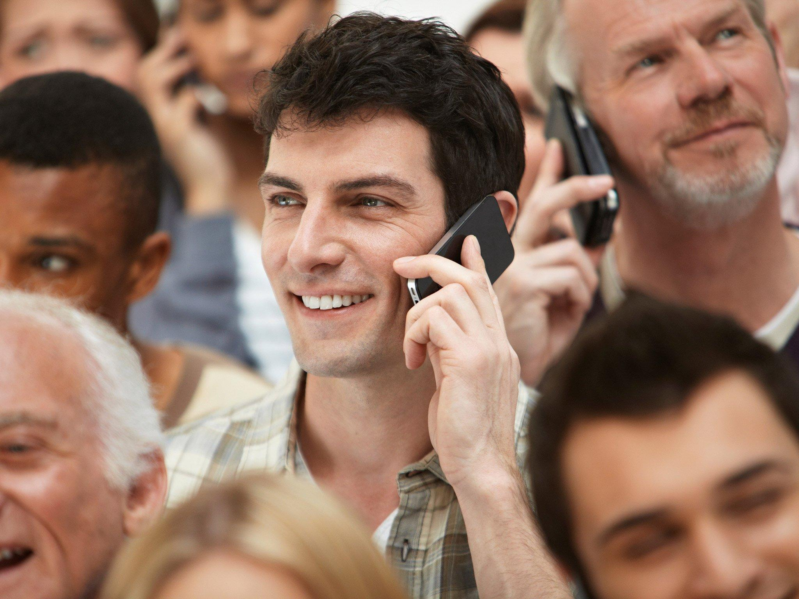
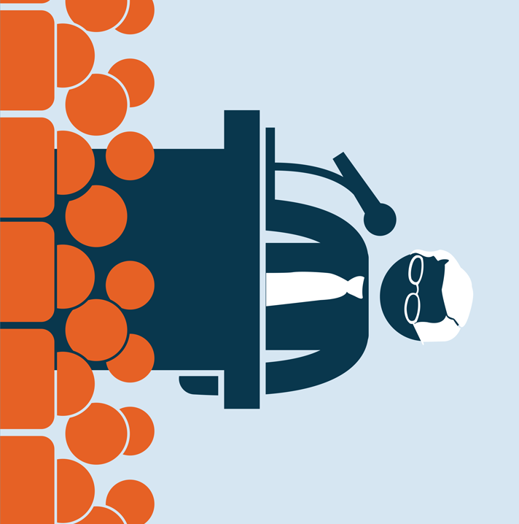
TARGET AUDIENCE
Evaluators can use it to produce better result in Group Discussions
Identification of different speaker broadcast devices
People doing Conference Calls

Slide 6
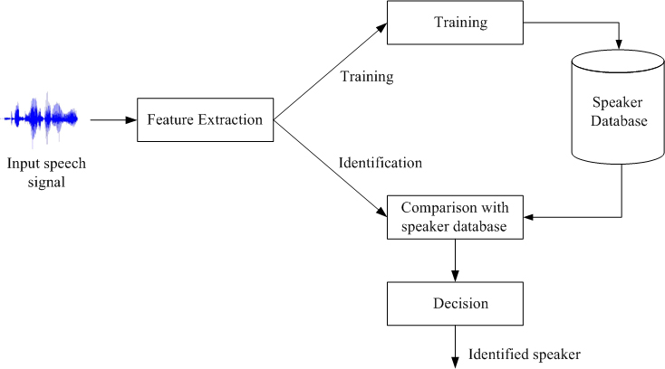
AUDIO EXTRACTION
Audio information plays a rather important role in the increasing digital content that is available today, resulting in a need for methodologies that automatically analyze The increasing availability of audio content, through a vast distribution of channels, has resulted in the need for systems that are capable of automatically analyzing this content. The voice will be picked using Microphones or Voice Clips, we will extract and separate Unique Voices. Train the Model to learn how to separate the Voice and further Classifying Different/Multiple Speakers.

Slide 7

TECHNOLOGY STACK & PLATFORM USED
Python
Deep Learning
Data Mining
Audio Extraction and Segmentation
Anaconda

Slide 8
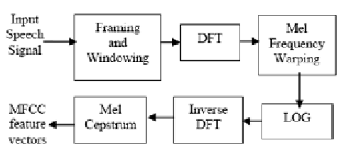
Mel Frequency Cepstral Coefficents (MFCCs)
Mel Frequency Cepstral Coefficents (MFCCs) are a feature widely used in automatic speech and speaker recognition.
The Mel scale relates perceived frequency, or pitch, of a pure tone to its actual measured frequency.
The shape of the vocal tract manifests itself in the envelope of the short time power spectrum, and the job of MFCCs is to accurately represent this envelope.
The cepstral domain (e.g. used by the MFCCs) results after applying the Inverse DFT on the logarithmic spectrum.

Slide 9
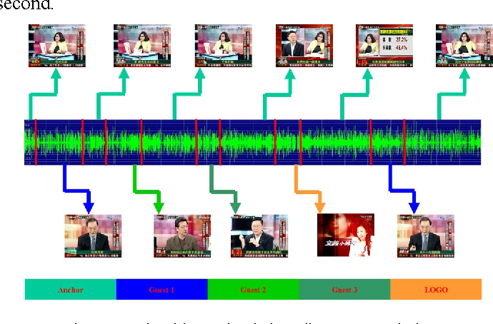
Audio Segmentation
Audio segmentation focuses on splitting an uninterrupted audio signal into segments of homogeneous content. The two general subcategories of audio segmentation:
the first contains algorithms that adopt some type of “prior” knowledge, e.g. a pre-trained classification scheme. For that type of segmentation the library provides a fix-sized joint segmentation—classification approach and an HMM-based method.
the second type of segmentation is either unsupervised or semi-supervised. In both cases, no prior knowledge on the involved classes of audio content is used. Typical examples are silence removal, speaker diarization and audio thumbnailing.

Slide 10
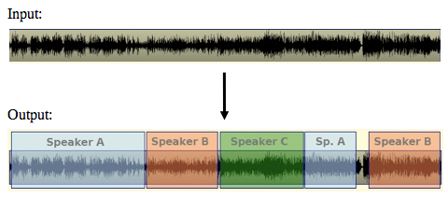
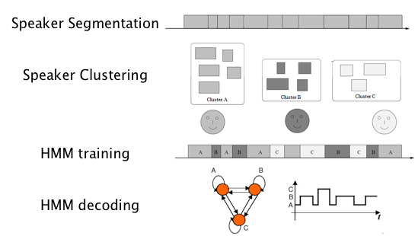
SPEAKER DIARIZATION
Speaker diarization is the task of automatically answering the question “who spoke when”, given a speech recording . Extracting such information can help in the context of several audio analysis tasks, such as audio summarization, speaker recognition and speaker-based retrieval of audio.
It can be achieved by Segmentation and clustering

Slide 11
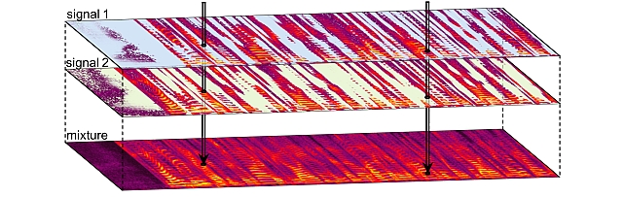
Clustering

Slide 12
LIBROSA
librosa.feature
Feature extraction and manipulation. This includes low-level feature extraction, such as chromagrams, pseudo-constant-Q (log-frequency) transforms, Mel spectrogram, MFCC, and tuning estimation. Also provided are feature manipulation methods, such as delta features, memory embedding, and event-synchronous feature alignment.
librosa.display
Visualization and display routines using matplotlib.
librosa.effects
Time-domain audio processing, such as pitch shifting and time stretching. This submodule also provides time-domain wrappers for the decompose submodule.

Slide 13
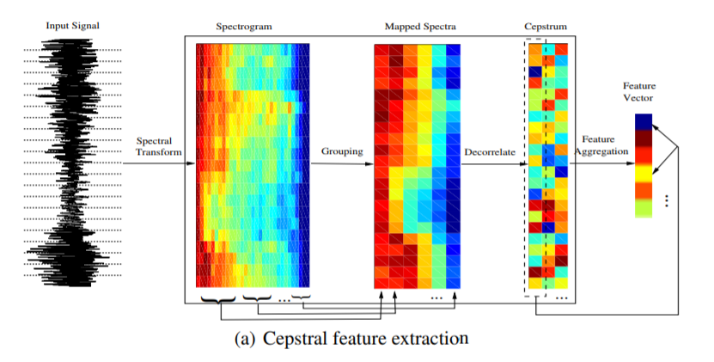
CEPSTRAL FEATURES

Slide 14
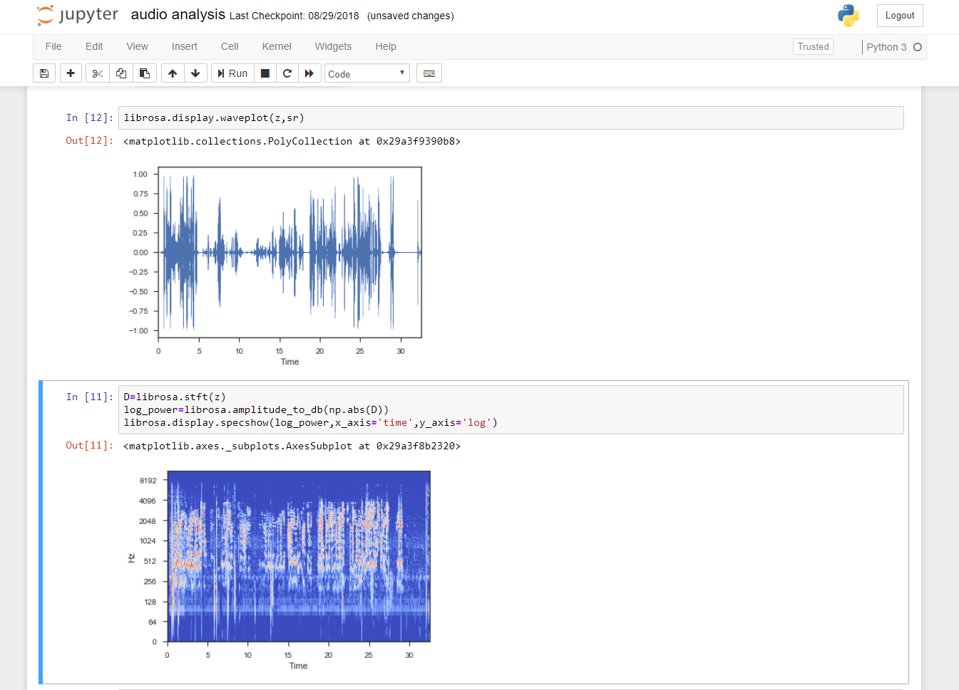

Slide 15
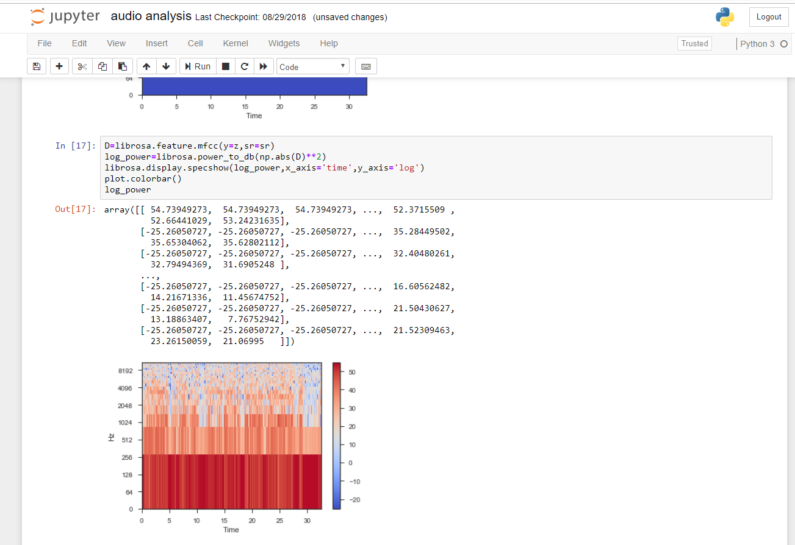

Slide 16
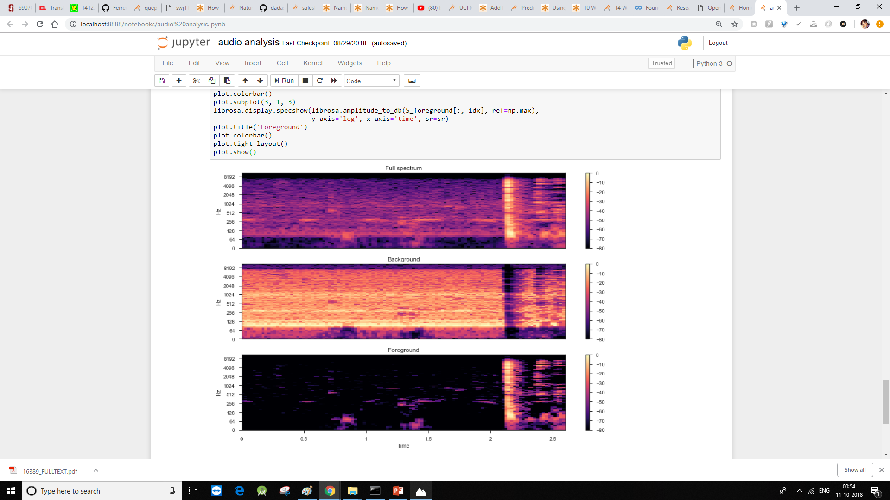

Slide 17
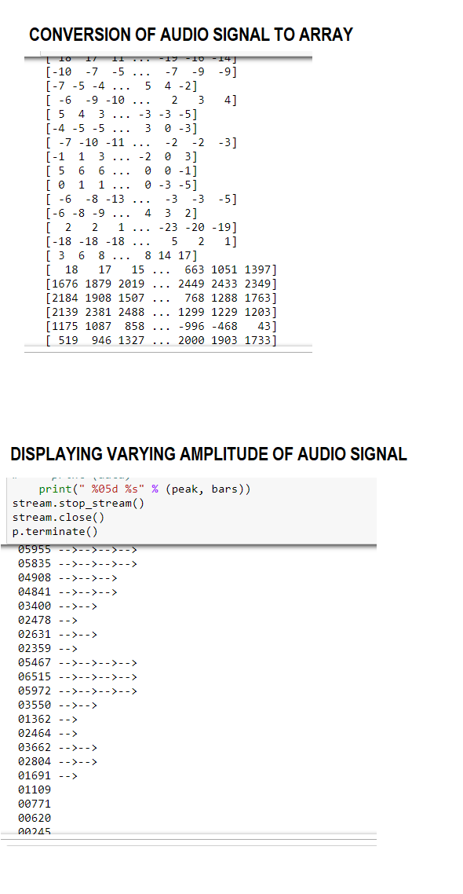
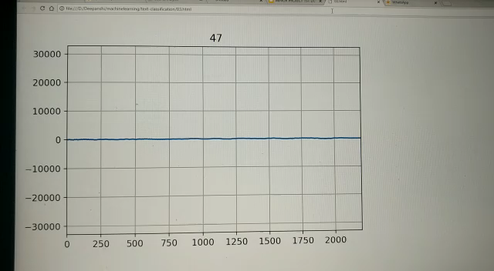
PROGRESS TILL 1st DEFENSE

Slide 18
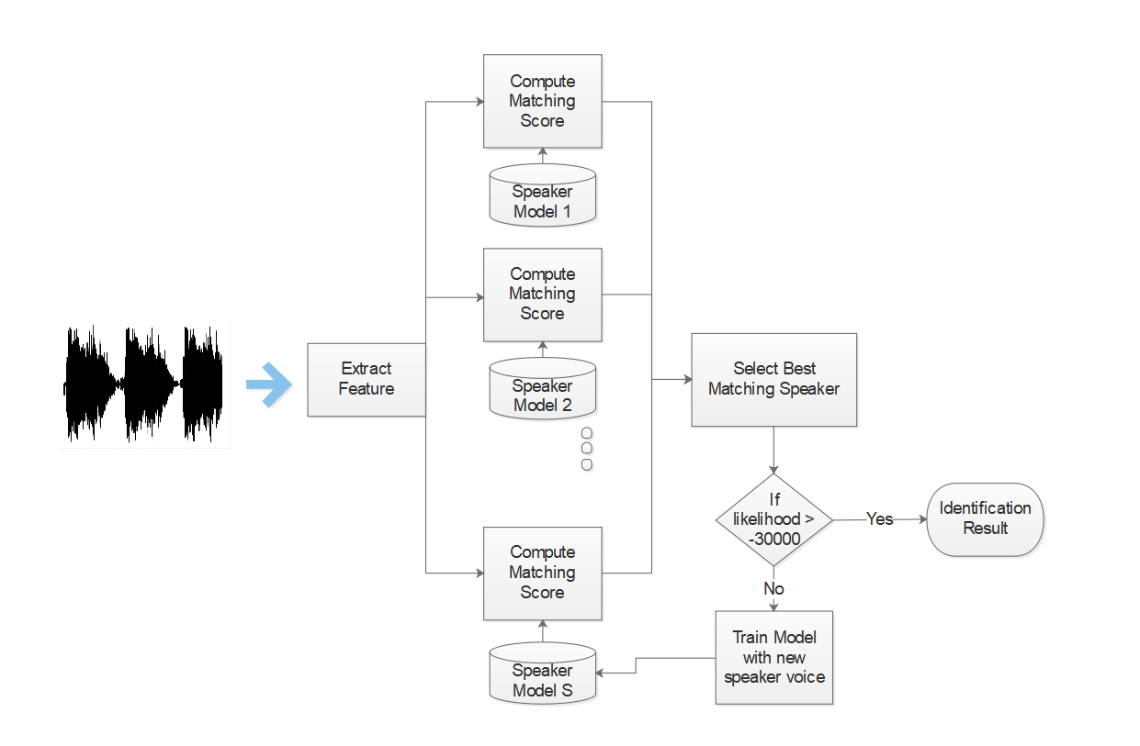
METHODOLOGY

Slide 19
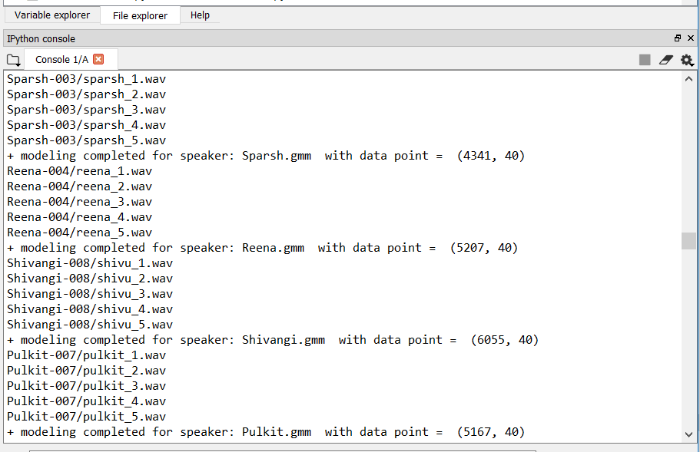
TRAINING OF MODEL

Slide 20
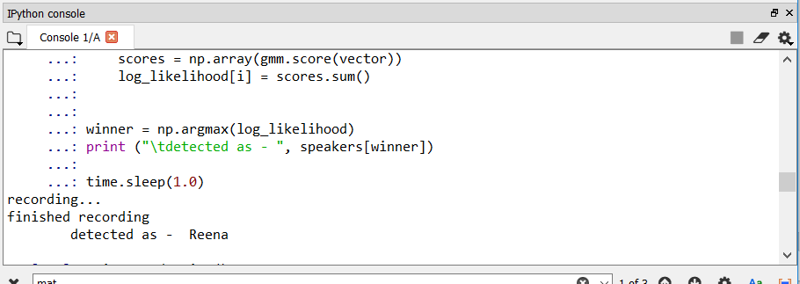
OUTPUT

Slide 21
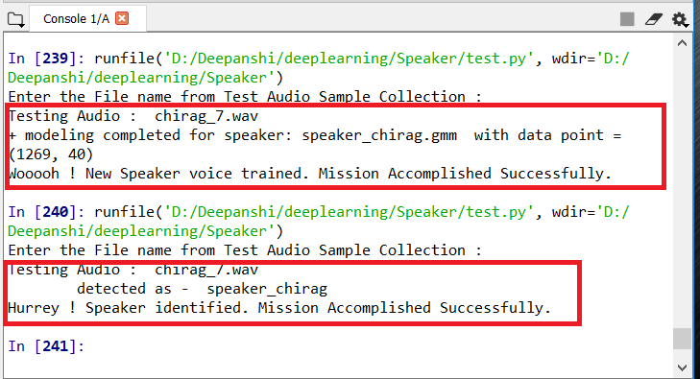
Continuous Learning

Slide 22
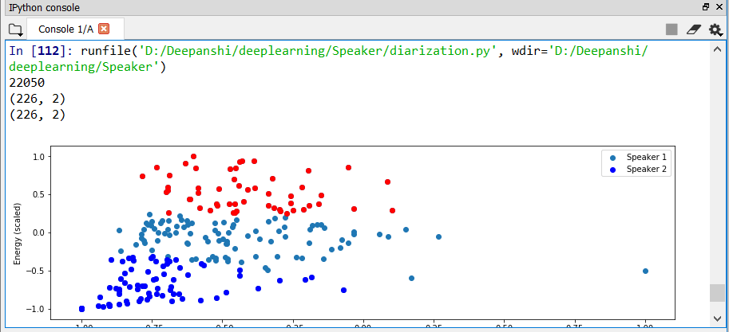
For Multiple

Slide 23
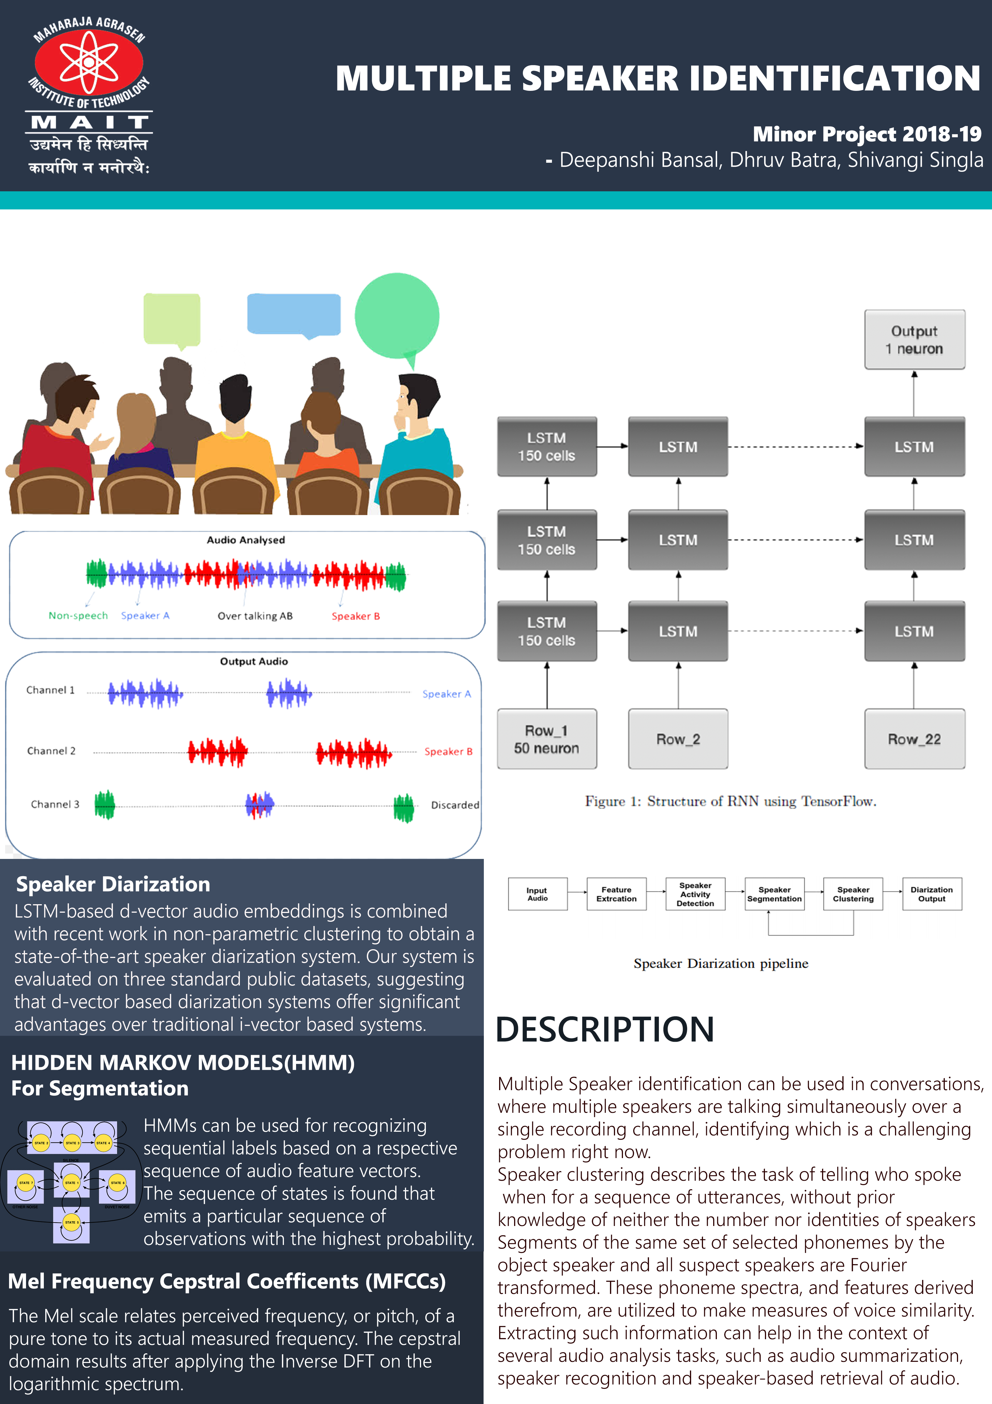
POSTER
POSTER

Slide 24
Thank You
Deepanshi Bansal
Shivangi Singla

